Slide 1
Automatic 2D Image mosaic CIS581 Computer Vision and Computational Photography
By, Urja Nadibail,
Student of MSE in CIS, University of Pennsylvania

Slide 2
Overview
Methodology with illustrations
Results
Challenges

Slide 3
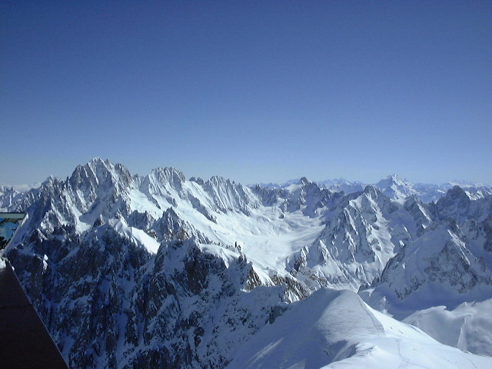
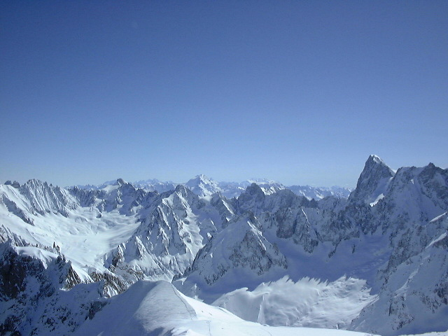
Input images

Slide 4
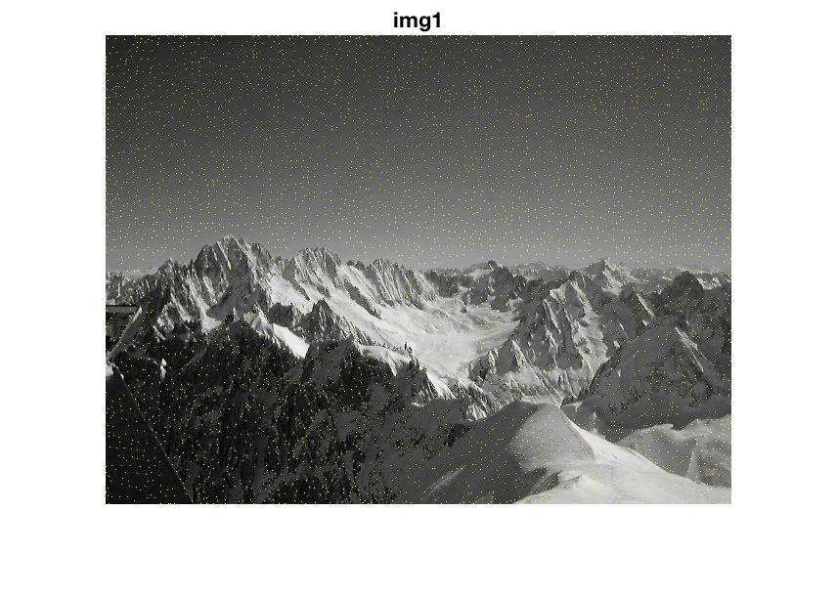
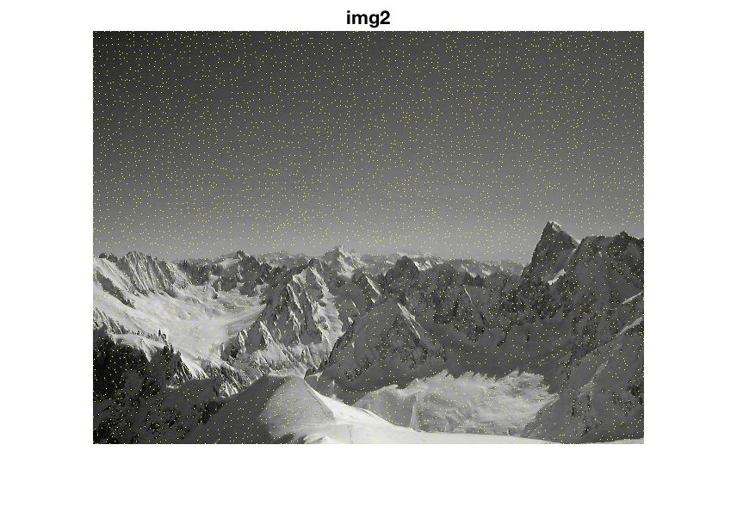
Corner detection on grey scale images

Slide 5
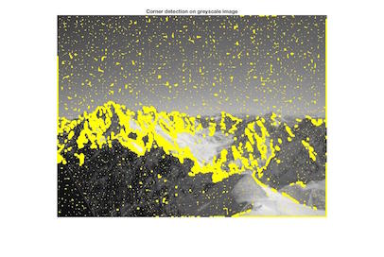
My implementation of Harris corner detector

Slide 6
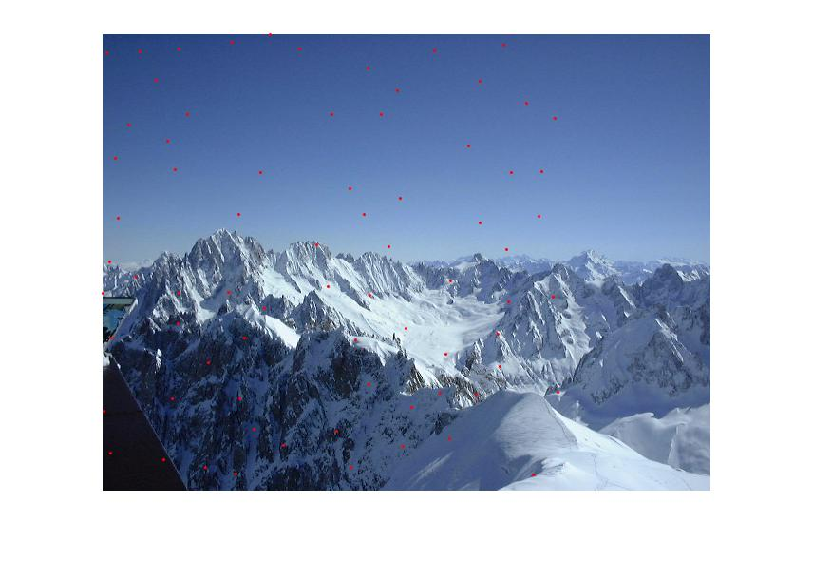
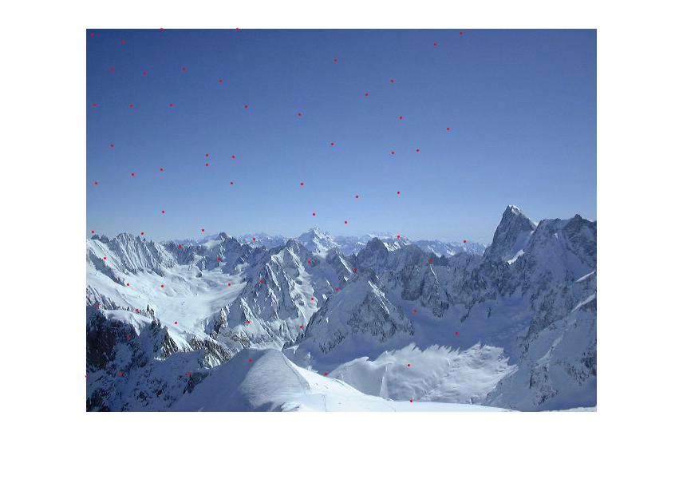
Adaptive Non maximal suppression

Slide 7


Adaptive non maximal suppression on my implementation of Harris corner detector
100 points
300 points

Slide 8


Matching results after RANSAC – inliers marked with blue dot and outliers with red cross

Slide 9
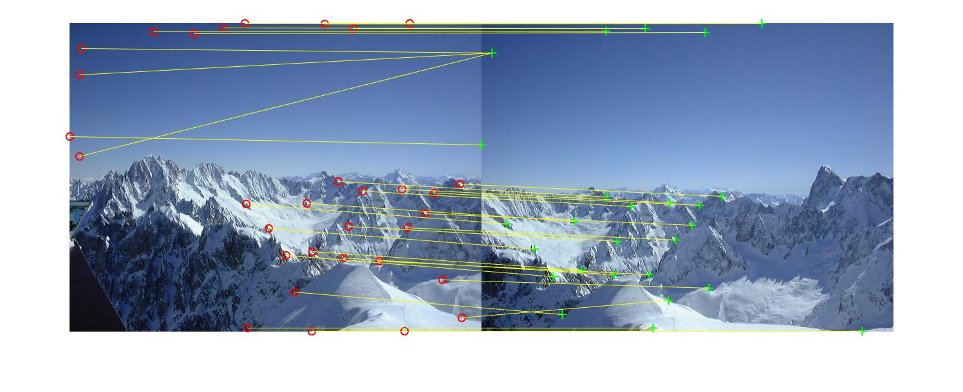
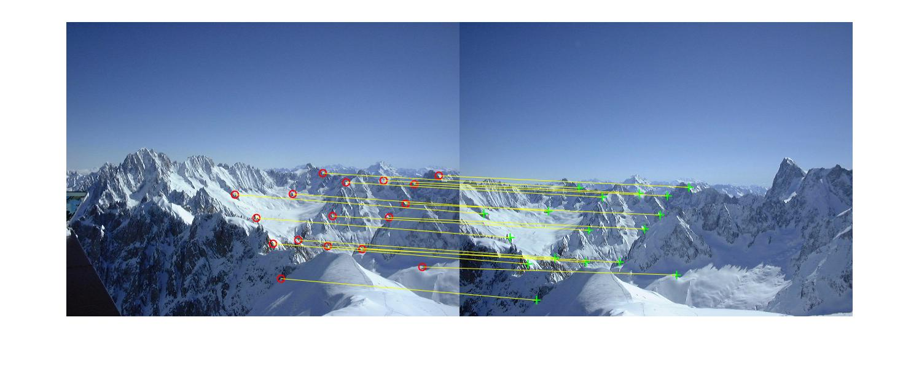
Before and after RANSAC

Slide 10
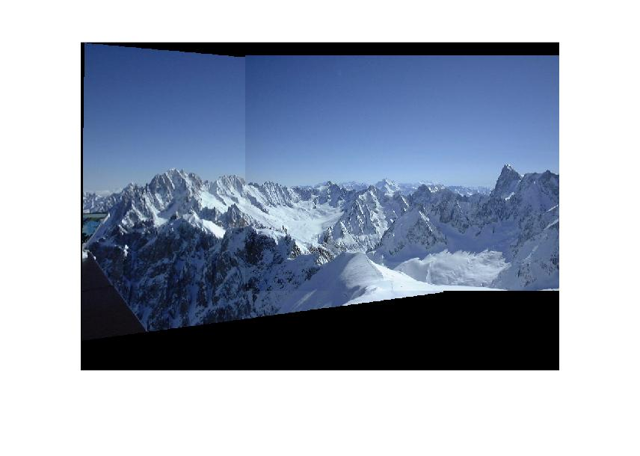
Final output: IMAGE MOSAIC

Slide 11
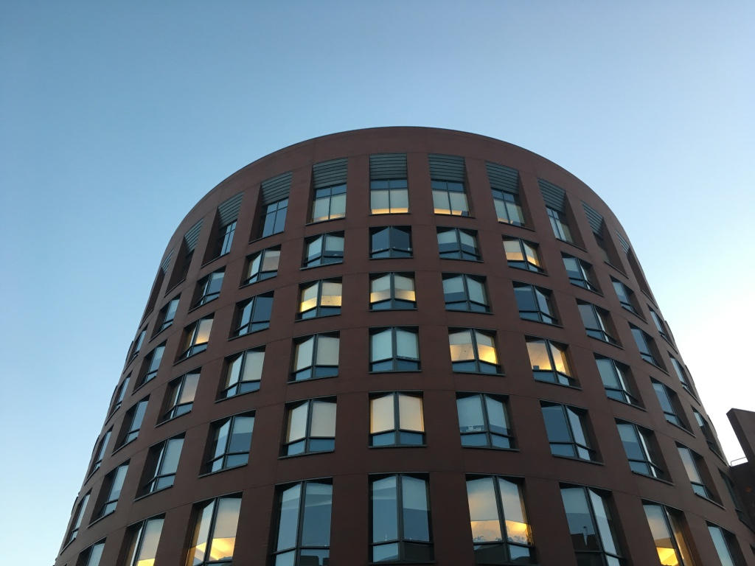
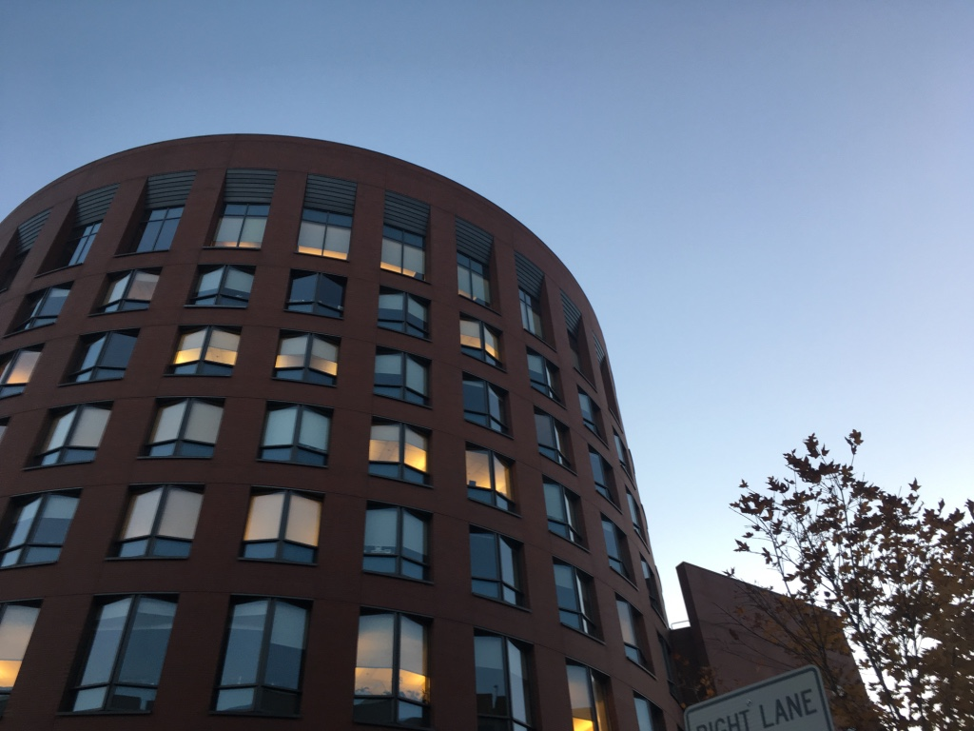
Input images

Slide 12
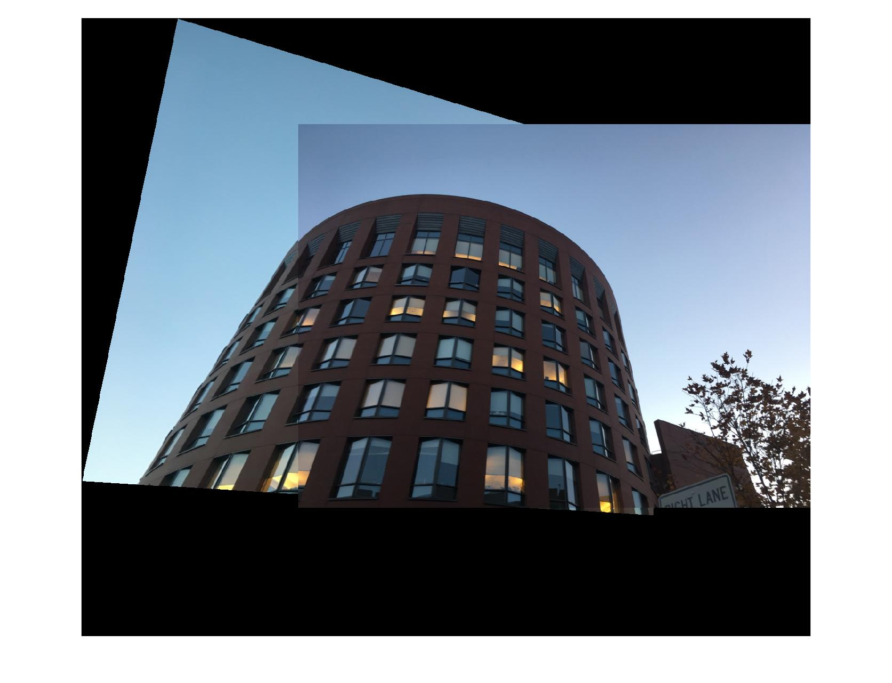
Image mosaic

Slide 13
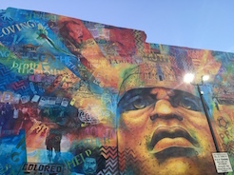
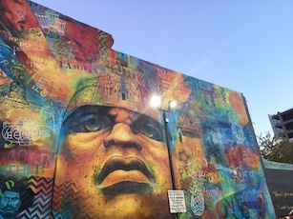
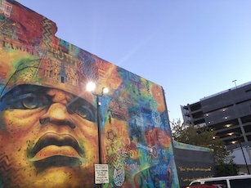
Input images

Slide 14
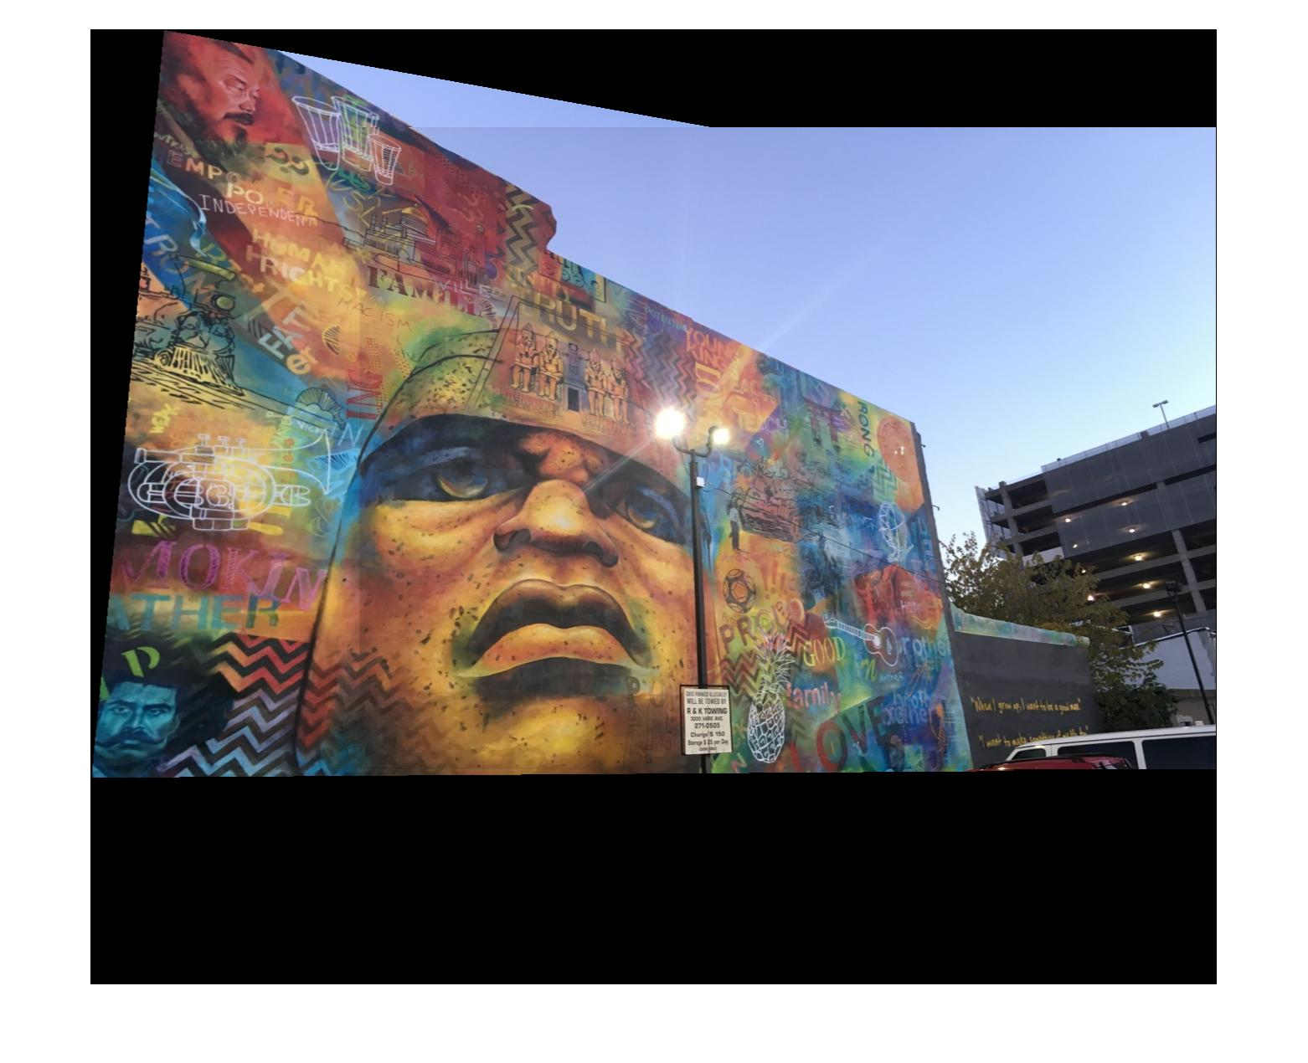
Image mosaic

Slide 15
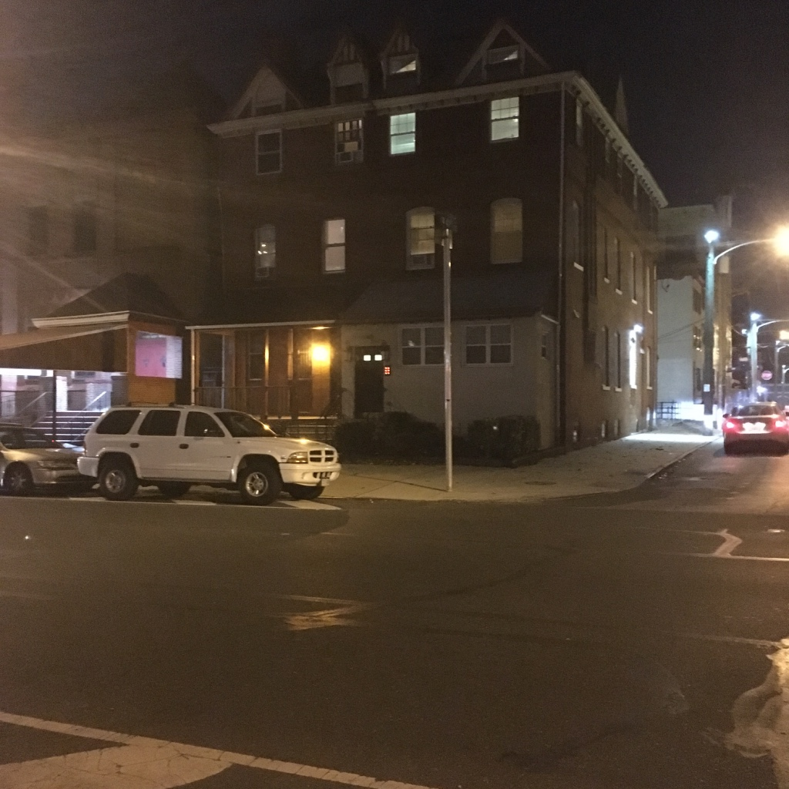
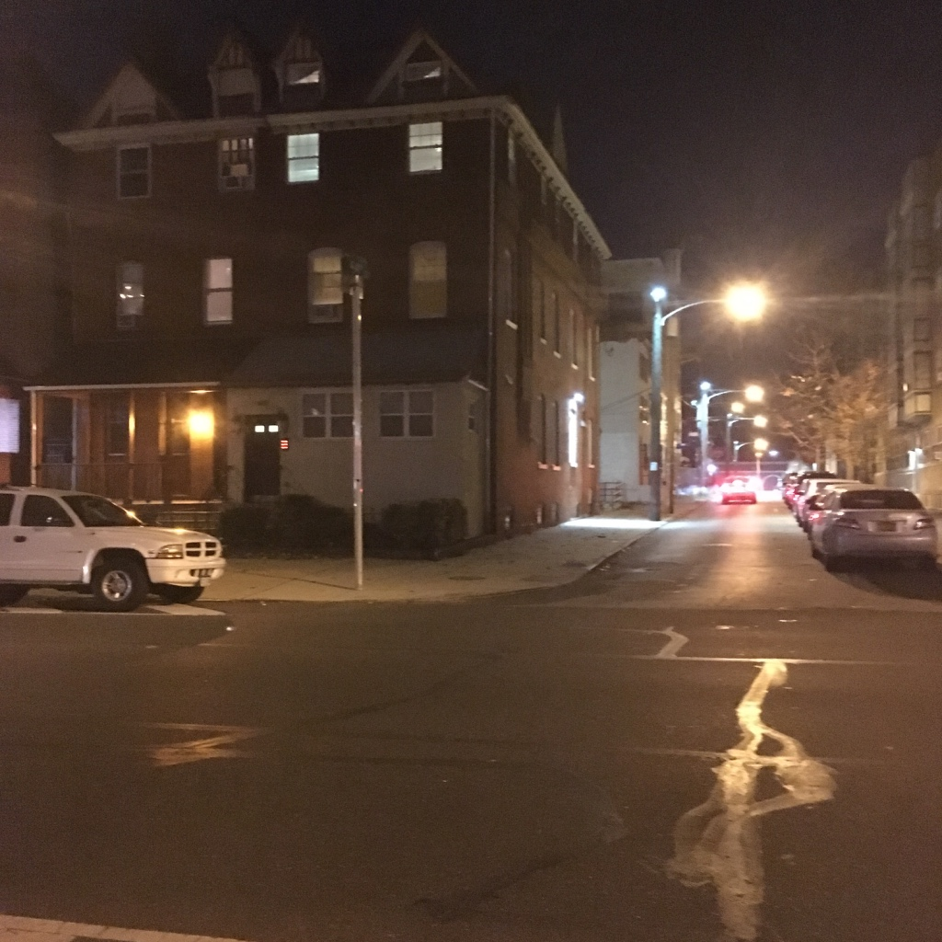
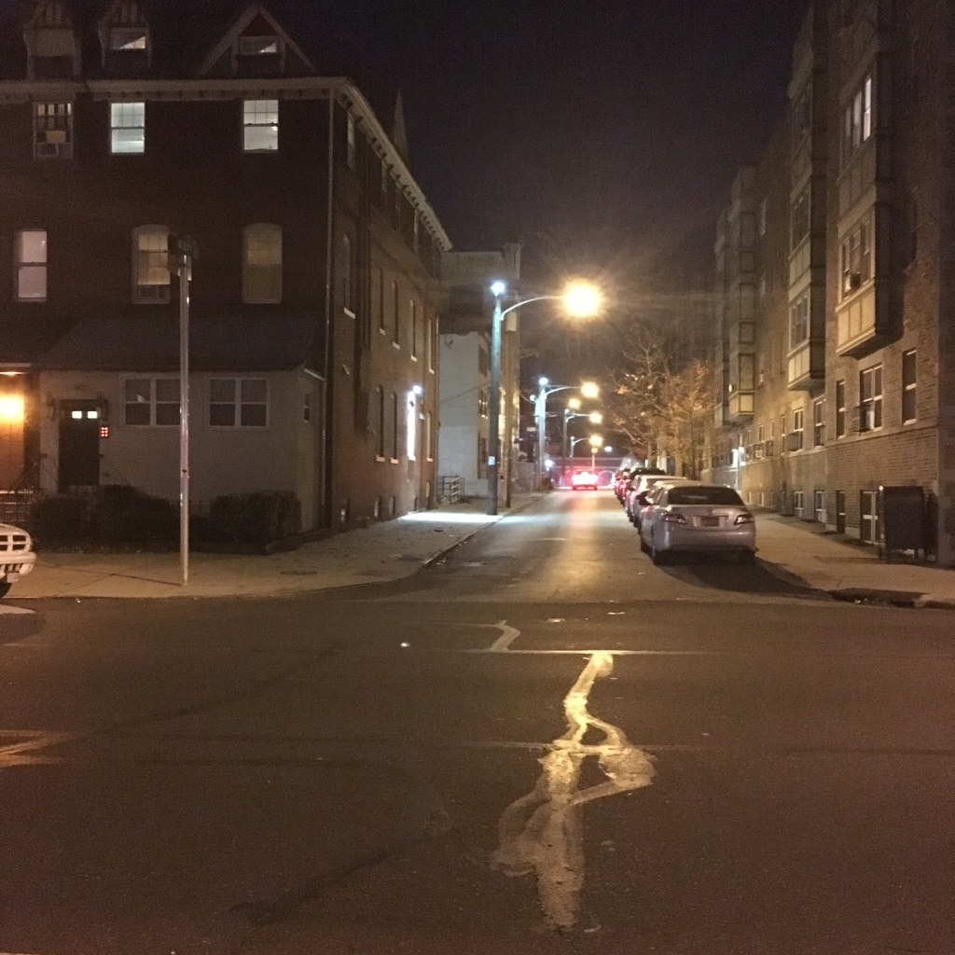
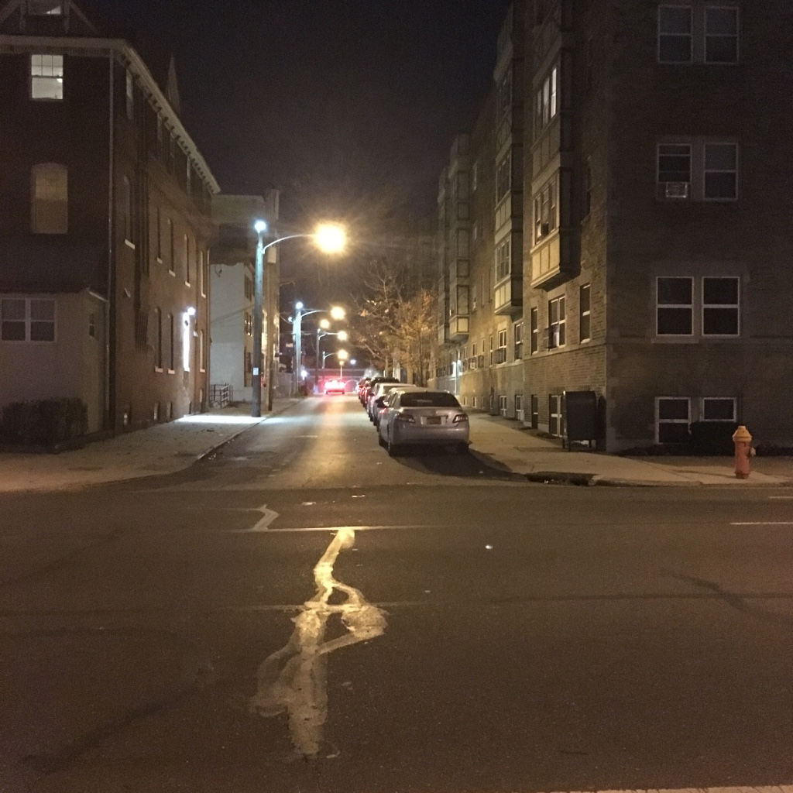
Input images

Slide 16
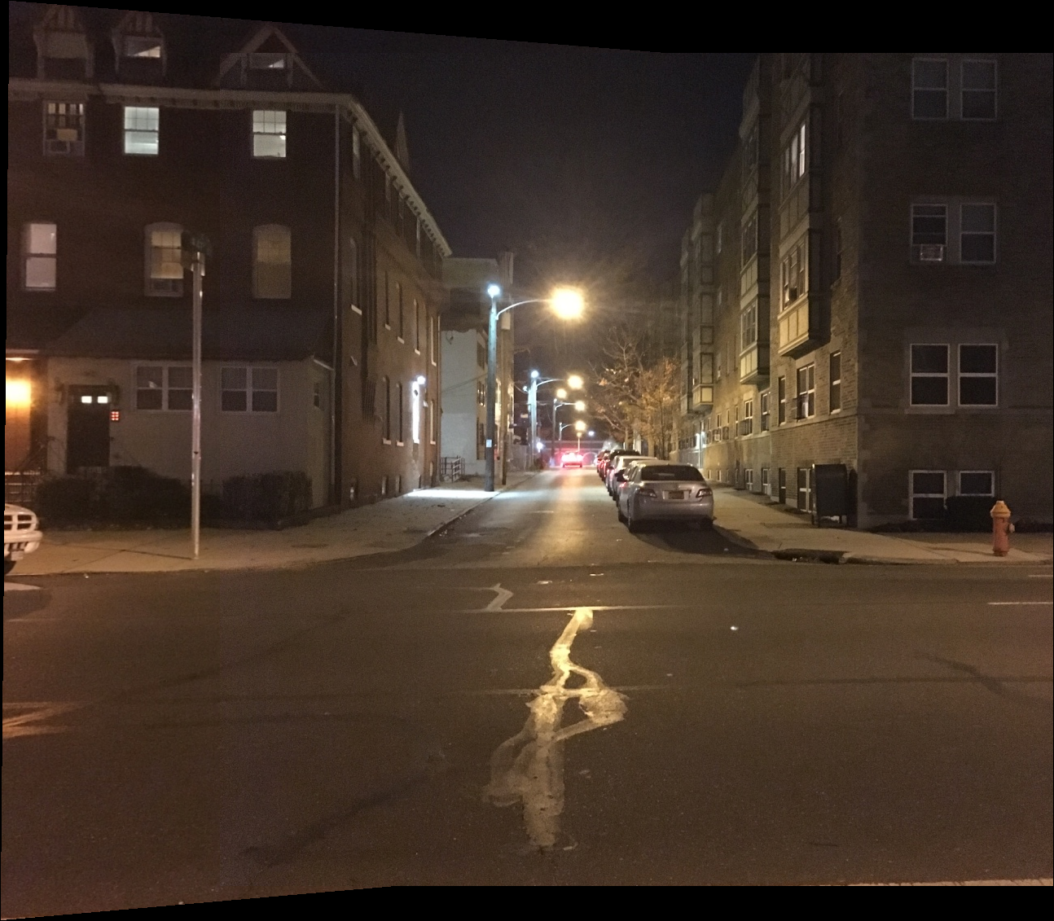
Final output: Image mosaic

Slide 17
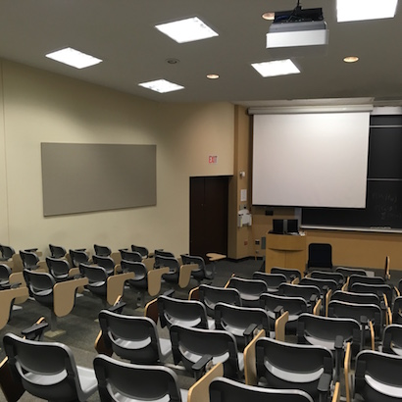
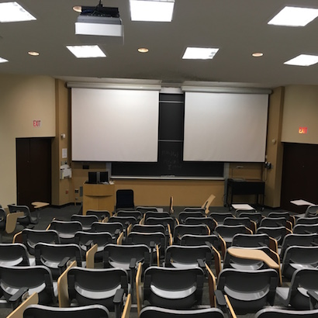
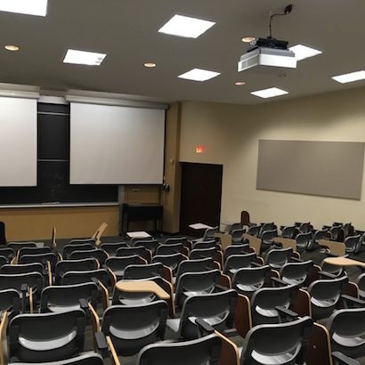
Input images

Slide 18
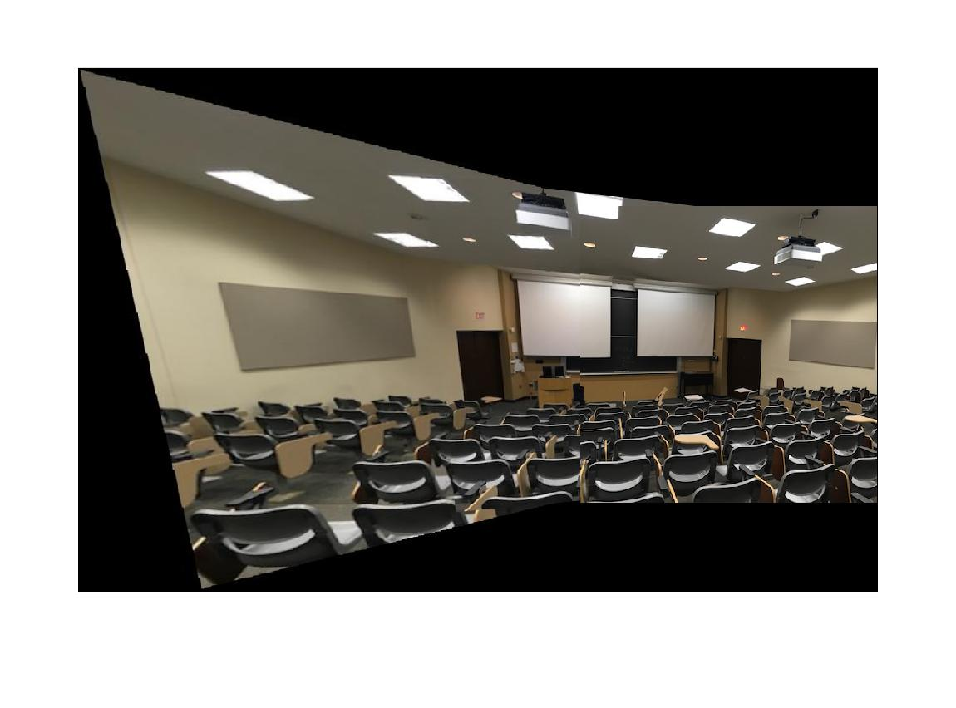
Image mosaic

Slide 19
Challenges
Debugging – Figuring out what was wrong
Interchanged indexes (x/y and i/j)
Stitching: inverse warping
Vectorizing for better performance

